Slide 1
Multimodal Deepfake Detection and Explainable Analysis
PROJECT STAGE-I REVIEW-II
Under the Guidance
Presentation by
Mrs. G. Uma Devi
Mr. Cherukuri Madhu (23C11A0584)
Assistant Professor,
Department of CSE
Mr. Sk. Mukheed Hussain (23C11A0594)
Department of Computer Science and Engineering

Slide 2
Contents
Introduction
Abstract
Base Paper
Literature Review
Existing Project
Drawbacks
Problem Statement
Proposed System
Objectives
Architecture
Software and Hardware Requirements
Modules
Design Diagrams
References

Slide 3
Introduction
Deepfake technology uses Artificial Intelligence and deep learning techniques to create highly realistic fake videos and audio that can appear to be genuine. Such manipulated media can create serious problems in areas like digital communication, banking, social media, law enforcement, and media verification. As deepfake generation techniques are becoming more advanced, detecting fake content using only manual methods is becoming difficult. Deepfakes can manipulate facial expressions, lip movements, voice, and other audiovisual characteristics, making it harder to distinguish them from genuine content. Therefore, automated detection methods are required to identify such manipulated media effectively. Analyzing both visual and audio information can provide more useful evidence for detecting sophisticated deepfakes. This project focuses on developing a multimodal deepfake detection system along with explainable analysis, so that the system not only identifies whether the media is Real or Fake but also provides understandable reasons for its prediction.

Slide 4
Abstract
Deepfake media is becoming increasingly difficult to detect because Artificial Intelligence can generate realistic audio and video content. This project proposes a multimodal deepfake detection system that analyses both visual and audio features to classify media as Real or Fake. It combines visual features such as facial movements and lip patterns with audio characteristics such as voice patterns and audio-video synchronisation. In addition to detection, the system provides explainable analysis to indicate possible reasons for the prediction. The proposed approach aims to improve the reliability and understandability of deepfake detection for secure digital communication.

Slide 5
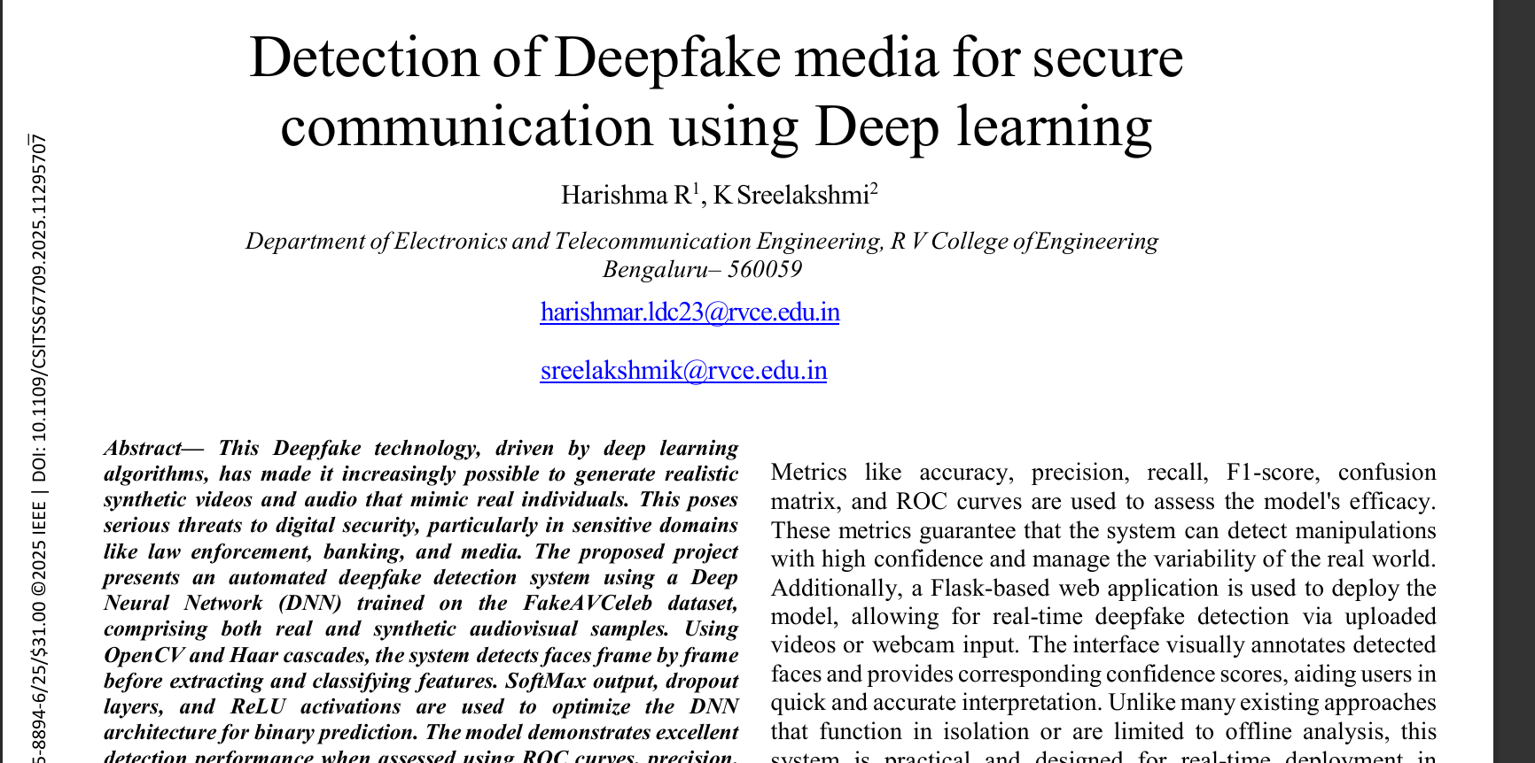
Base Paper

Slide 6
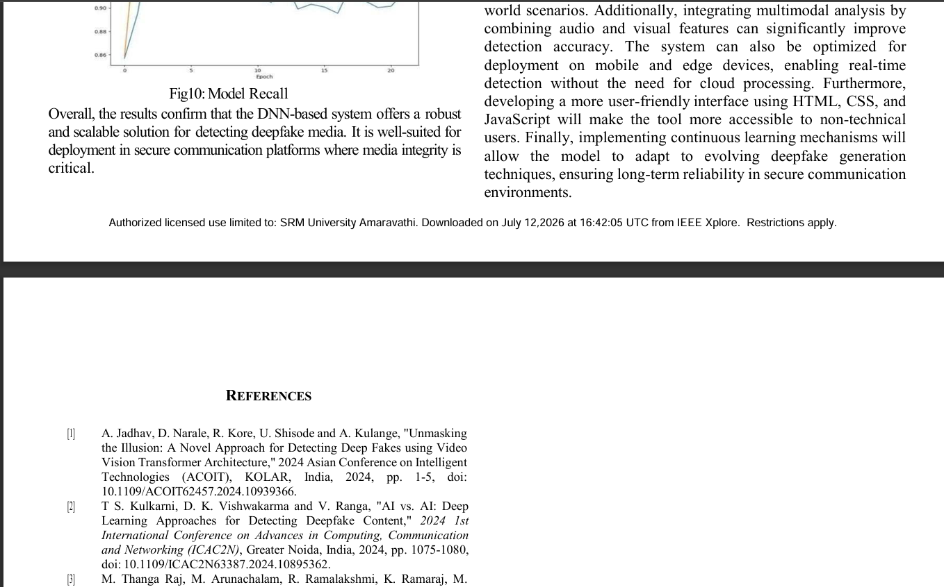
Base Paper (Contd…)

Slide 7
Literature Review
Paper 1: Base Paper
Title: Detection of Deepfake Media for Secure Communication using Deep Learning.
Authors: Harishma R and K. Sreelakshmi.
Publication: 2025 9th International Conference on Computational System and Information Technology for Sustainable Solutions (CSITSS), IEEE.
Key Takeaway: The paper provides a DNN-based foundation for deepfake detection using audiovisual data. Its approach gives us a basis for Real/Fake classification and performance evaluation. Its future scope motivates our multimodal and explainable detection approach.
Notes:
Paper 1
Title: A Robust Approach to Multimodal Deepfake Detection
Authors: Davide Salvi, Honggu Liu, Sara Mandelli, Paolo Bestagini, Wenbo Zhou, Weiming Zhang, and Stefano Tubaro (2023).
What we take from the paper: Multimodal analysis improves deepfake detection but still faces cross-modal and generalization challenges.
Our project goes beyond Real/Fake classification by analyzing why the media is suspicious.
It provides explainable results with the detected audio-visual inconsistencies.
Paper 2
Title: Integrating Audio-Visual Features for Multimodal Deepfake Detection
Authors: Sneha Muppalla, Shan Jia, and Siwei Lyu (2023).
What we take from the paper: Audio-visual feature integration provides stronger deepfake detection. It supports both Real/Fake classification and detailed manipulation analysis. This motivates us to combine multiple features in our proposed system.
Paper 3
Title: Joint Audio-Visual Deepfake Detection
Authors: Yipin Zhou and Ser-Nam Lim (2021).
What we take from the paper: Joint analysis of audio and video improves deepfake detection. Audio-video synchronization provides an important clue for identifying manipulated media. We can use this consistency analysis in our proposed system.
Paper 4
Title: Deepfake Generation and Detection: Case Study and Challenges
Authors: Yogesh Patel et al. (2023).
What we take from the paper: The paper highlights major deepfake generation and detection techniques. It identifies challenges related to datasets, generalization, and reliable detection. These challenges guide us toward developing a more robust detection system.
(first )Base Paper
Title: Detection of Deepfake Media for Secure Communication using Deep Learning
Authors: Harishma R and K. Sreelakshmi.
What we take from the paper: The paper provides a DNN-based foundation for deepfake detection using audiovisual data. Its approach gives us a basis for Real/Fake classification and performance evaluation. Its future scope motivates our multimodal and explainable detection approach.

Slide 8
Literature Review (Contd…)
Paper 2
Title: A Robust Approach to Multimodal Deepfake Detection
Authors: Davide Salvi, Honggu Liu, Sara Mandelli, Paolo Bestagini, Wenbo Zhou, Weiming Zhang, and Stefano Tubaro (2023).
Publication: Journal of Imaging, Volume 9, Issue 6, Article 122, MDPI, 2023.
Key Takeaway: Multimodal analysis improves deepfake detection but still faces cross-modal and generalization challenges. Our project goes beyond Real/Fake classification by analyzing why the media is suspicious. It provides explainable results with the detected audio-visual inconsistencies.

Slide 9
Literature Review (Contd…)
Paper 3
Title: Integrating Audio-Visual Features for Multimodal Deepfake Detection.
Author: Sneha Muppalla, Shan Jia, and Siwei Lyu (2023).
Publication: 2023 IEEE MIT Undergraduate Research Technology Conference (URTC).
Key Takeaway: Audio-visual feature integration provides stronger deepfake detection. It supports both Real/Fake classification and detailed manipulation analysis. This motivates us to combine multiple features in our proposed system.

Slide 10
Literature Review (Contd…)
Paper 4
Title: A Multimodal Framework for Robust Propaganda Detection in Digital News Media.
Authors: Swetha Manikandan, Qazi Mazhar Ul Haq, Faiz Ul Islam.
Publication: 2025 International Conference on Communication Technologies (ComTech), IEEE.
Key Takeaway: Uses CNNs for visual feature extraction and NLP for text analysis, fusing audio and text modalities to identify propaganda.

Slide 11
Existing Project
Existing deepfake detection systems use different deep learning and computer vision techniques to identify manipulated images, videos, and audio. Many approaches analyze facial features, frame-level information, facial movements, and voice patterns to distinguish real content from fake content. Some systems use CNNs or DNNs for visual feature extraction, while others use temporal or multimodal analysis to identify inconsistencies across video and audio. The system considered in this project uses the FakeAVCeleb dataset containing real and AI-generated audiovisual samples, extracts facial regions from video frames using OpenCV and Haar Cascade, and uses a DNN for Real/Fake classification.

Slide 12
Drawbacks
The existing system mainly focuses on facial and visual information for detection.
It may face challenges with compressed and low-resolution videos.
The model may not perform consistently on different datasets and manipulation techniques.
It does not provide a clear explanation of why the input was classified as Fake.
It needs to adapt to new deepfake generation techniques that may appear in the future.

Slide 13
Problem Statement
Deepfake audio and video are becoming increasingly difficult to distinguish from genuine media. A reliable system is needed to detect such manipulated content using both audio and visual features and provide a clear explanation for its prediction.

Slide 14
Proposed System
Develop a multimodal deepfake detection system using both audio and visual information.
Extract facial and video features from the input media.
Extract audio features such as voice characteristics and speech patterns.
Combine the audio and visual features for Real/Fake classification.
Provide an explainable analysis along with the prediction.
Display the result with a confidence score and the identified reasons for the prediction.

Slide 15
Objectives
To detect deepfake media using both audio and visual features.
To improve detection by combining information from multiple modalities.
To identify possible audio-video inconsistencies in manipulated media.
To provide an understandable explanation for the Real/Fake prediction.
To improve the reliability of deepfake detection for secure digital communication.

Slide 16
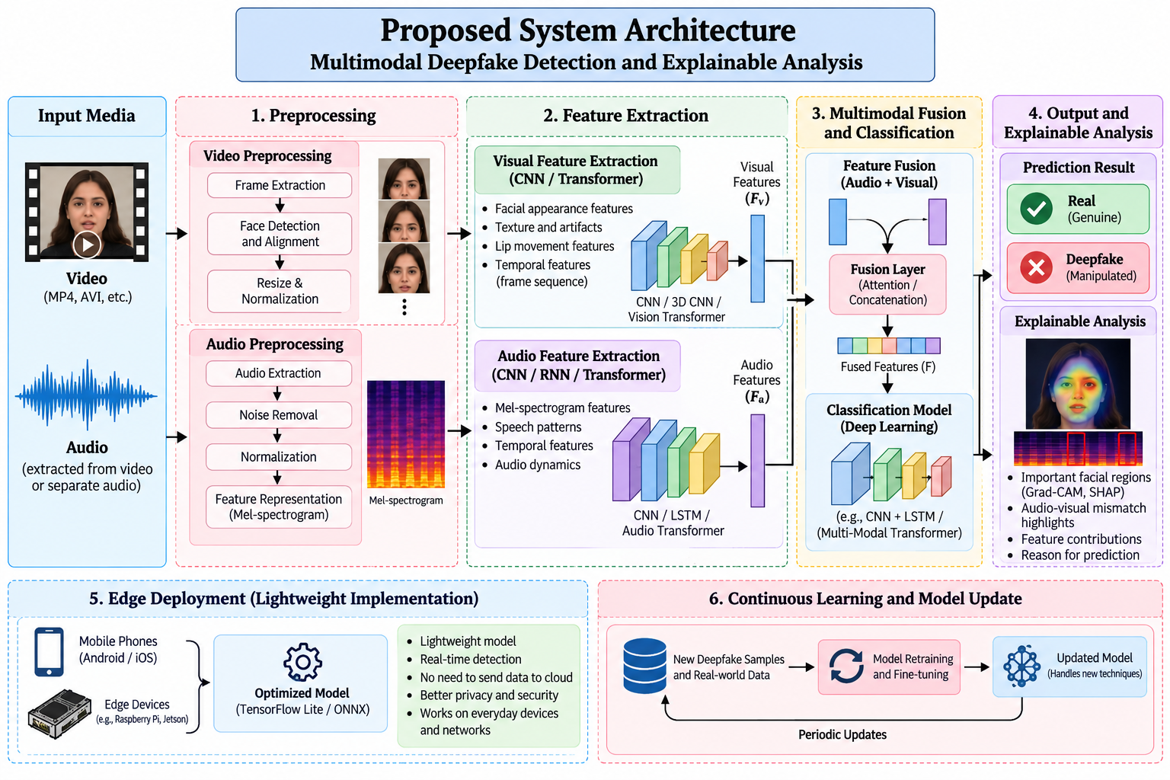
Architecture

Slide 17
Software and Hardware Requirements
Software Requirements
Operating System: Windows / Linux
Programming language: Python
Jupyter Notebook - Development environment / VS Code
Visualization: Matplotlib
Git & GitHub - Version control and project management
Hardware Requirements
Processor: Intel Core i5 or equivalent.
RAM: Minimum 8 GB.
Storage: At least 10–20 GB free space.
System: Laptop/Desktop computer.
Notes:
Operating System: Windows / LinuxProgramming Language: PythonDevelopment Environment: Jupyter Notebook / VS CodeVisualization: MatplotlibWeb Framework: FlaskDataset: FakeAVCeleb

Slide 18
Modules
1. User Interface Module
  Allows users to upload videos.
  Displays video details and detection results.
2. Video Upload and Validation Module
  Accepts and validates video files.
  Checks file format, size, and compatibility.
3. Video Preprocessing Module
  Extracts frames using OpenCV and FFmpeg.
  Resizes, normalises, and selects important frames.
4. Face Detection and Extraction Module
  Detects human faces in video frames.
  Extracts facial regions for model analysis.
5. Video-Based Deepfake Detection Module
  Analyses facial frames using deep learning.
  Detects visual manipulation patterns.
  Generates Real/Fake predictions with confidence scores.

Slide 19
Modules (cont.)
6. Audio Extraction and Preprocessing Module
  Extracts audio from the uploaded video.
  Converts audio into the required format.
  Generates MFCC or Mel-spectrogram features.
7. Audio-Based Deepfake Detection Module
  Analyzes audio features using deep learning.
  Identifies synthetic or manipulated speech.
  Generates audio-based predictions and confidence scores.
8. Multimodal Fusion Module
  Combines video and audio predictions or features.
  Applies fusion techniques.
  Produces the final Real/Fake classification.
9. Explainable Analysis Module
  Provides supporting evidence for predictions.
  Highlights important facial regions using Grad-CAM, if implemented.
  Identifies audio-video inconsistencies, if supported.
10. Results and Report Generation Module
  Displays final Real/Fake classification.
  Shows audio and video confidence scores.
  Presents analysis results and generates downloadable reports, if implemented.

Slide 20
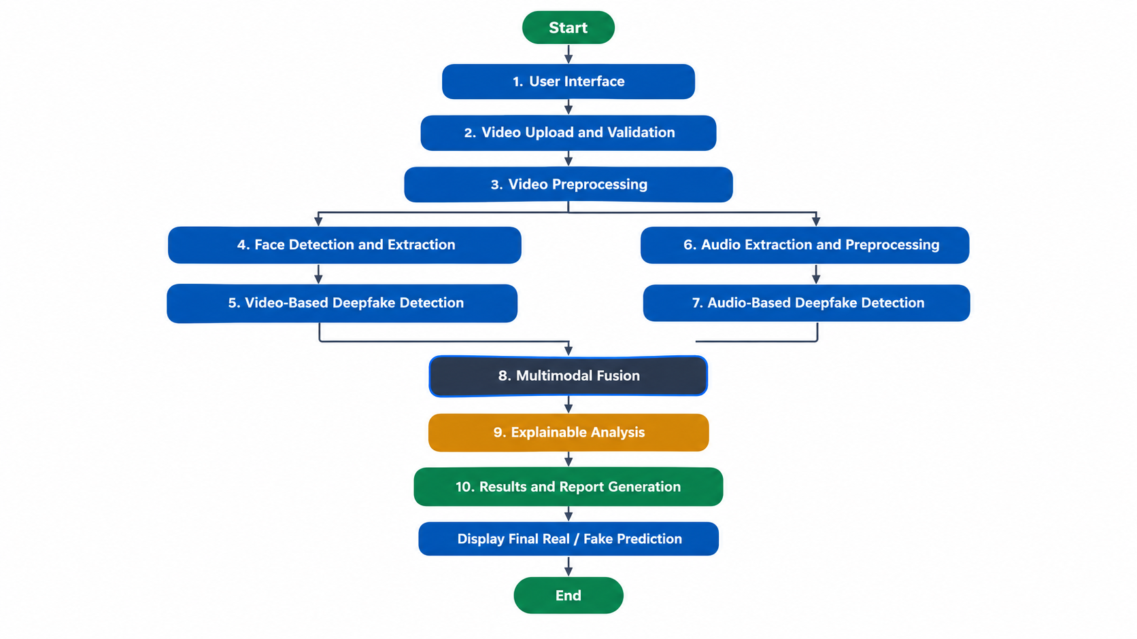
Modules (cont.)

Slide 21
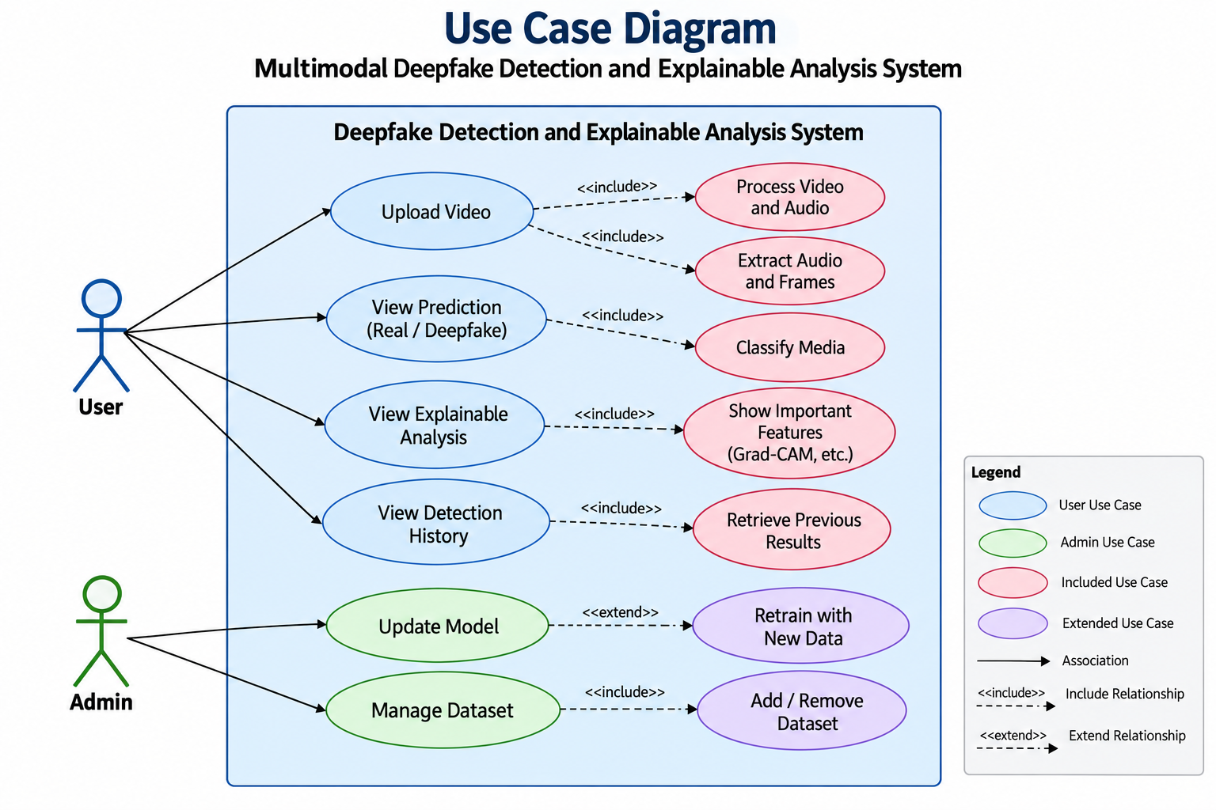
Design Diagrams

Slide 22
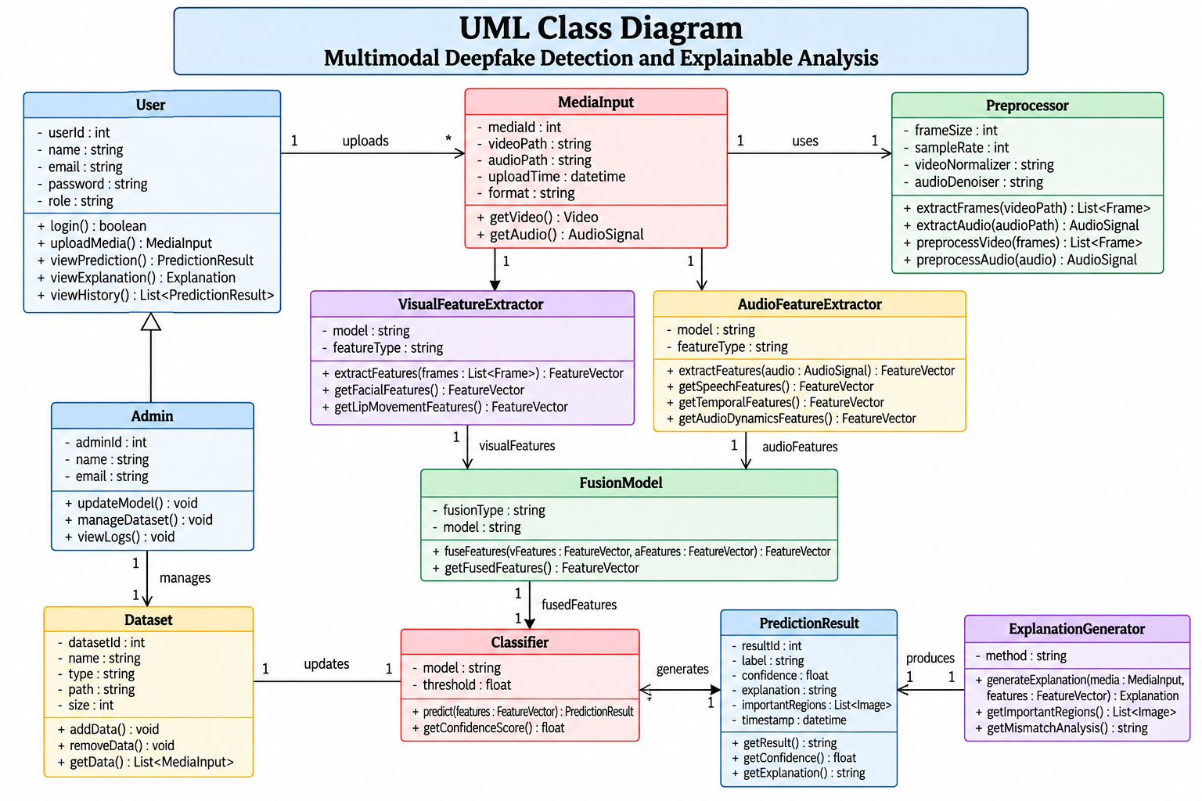
Design Diagrams (cont.)

Slide 23
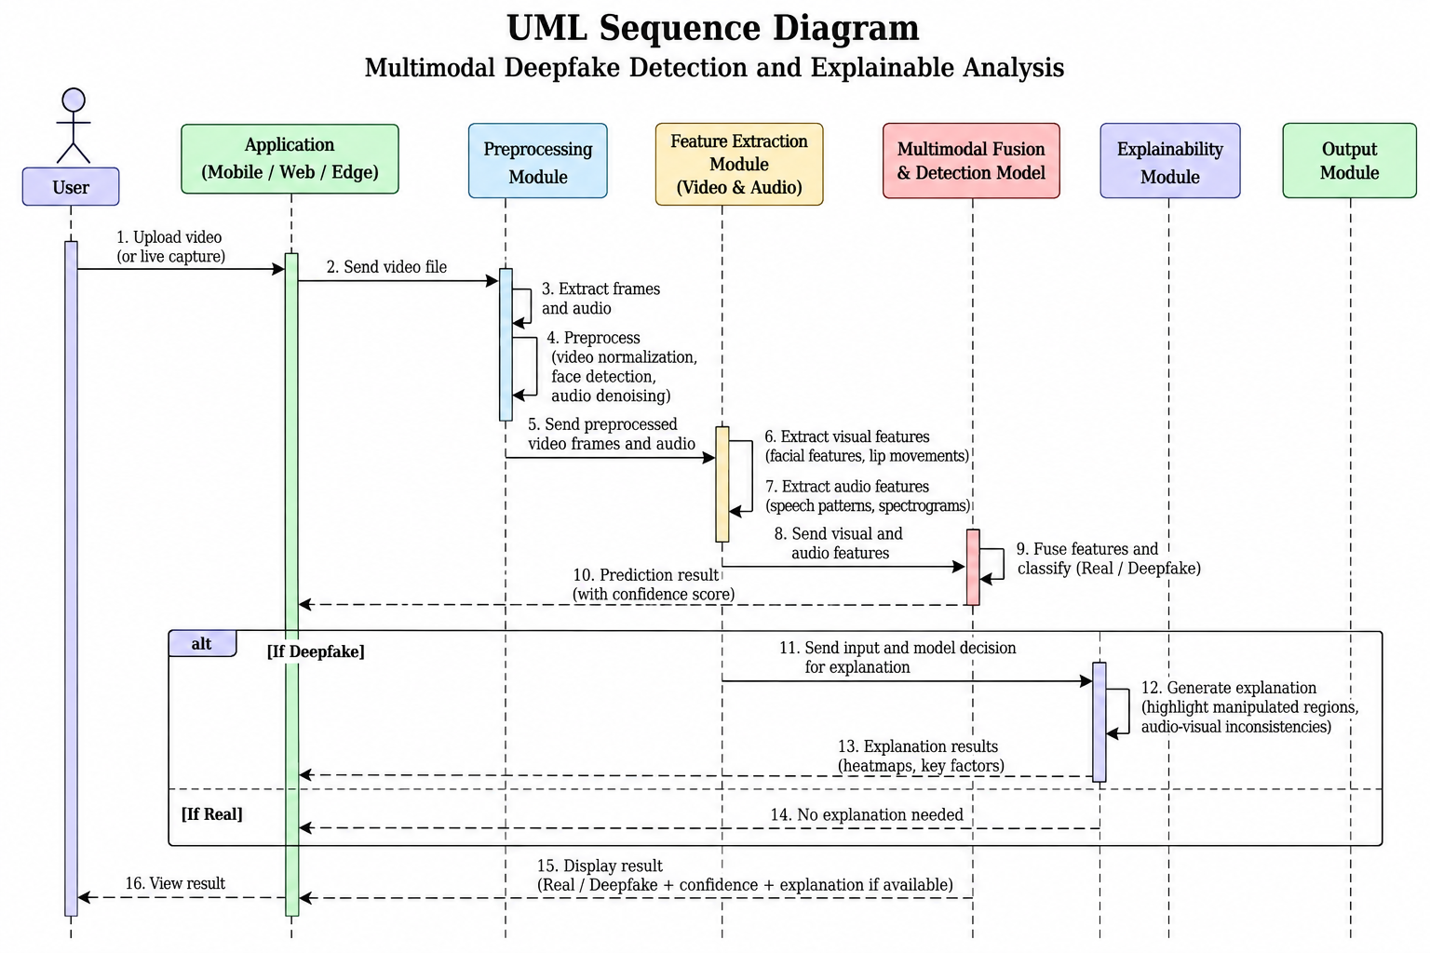
Design Diagrams (cont.)

Slide 24
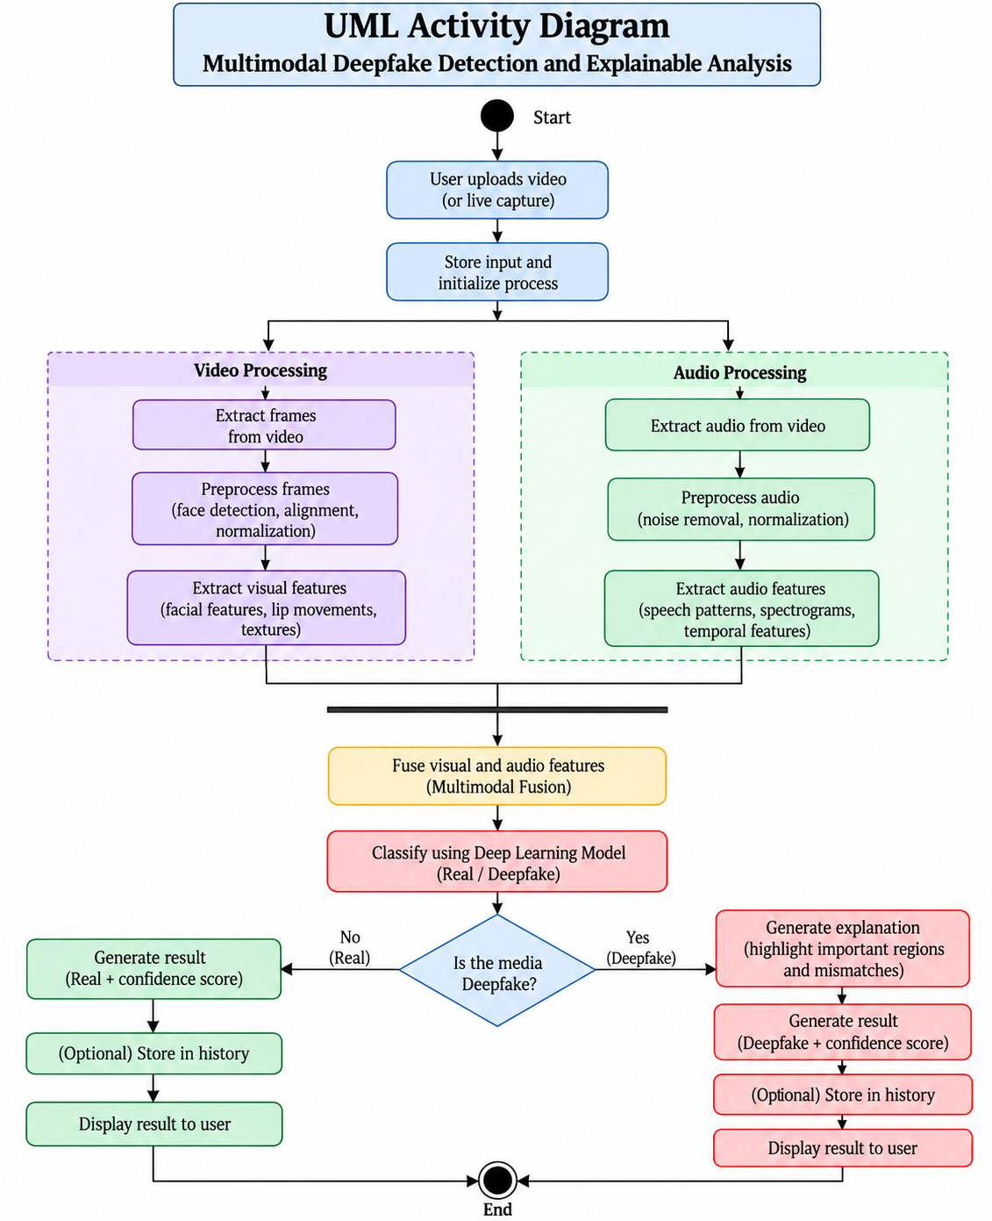
Design Diagrams (cont.)

Slide 25
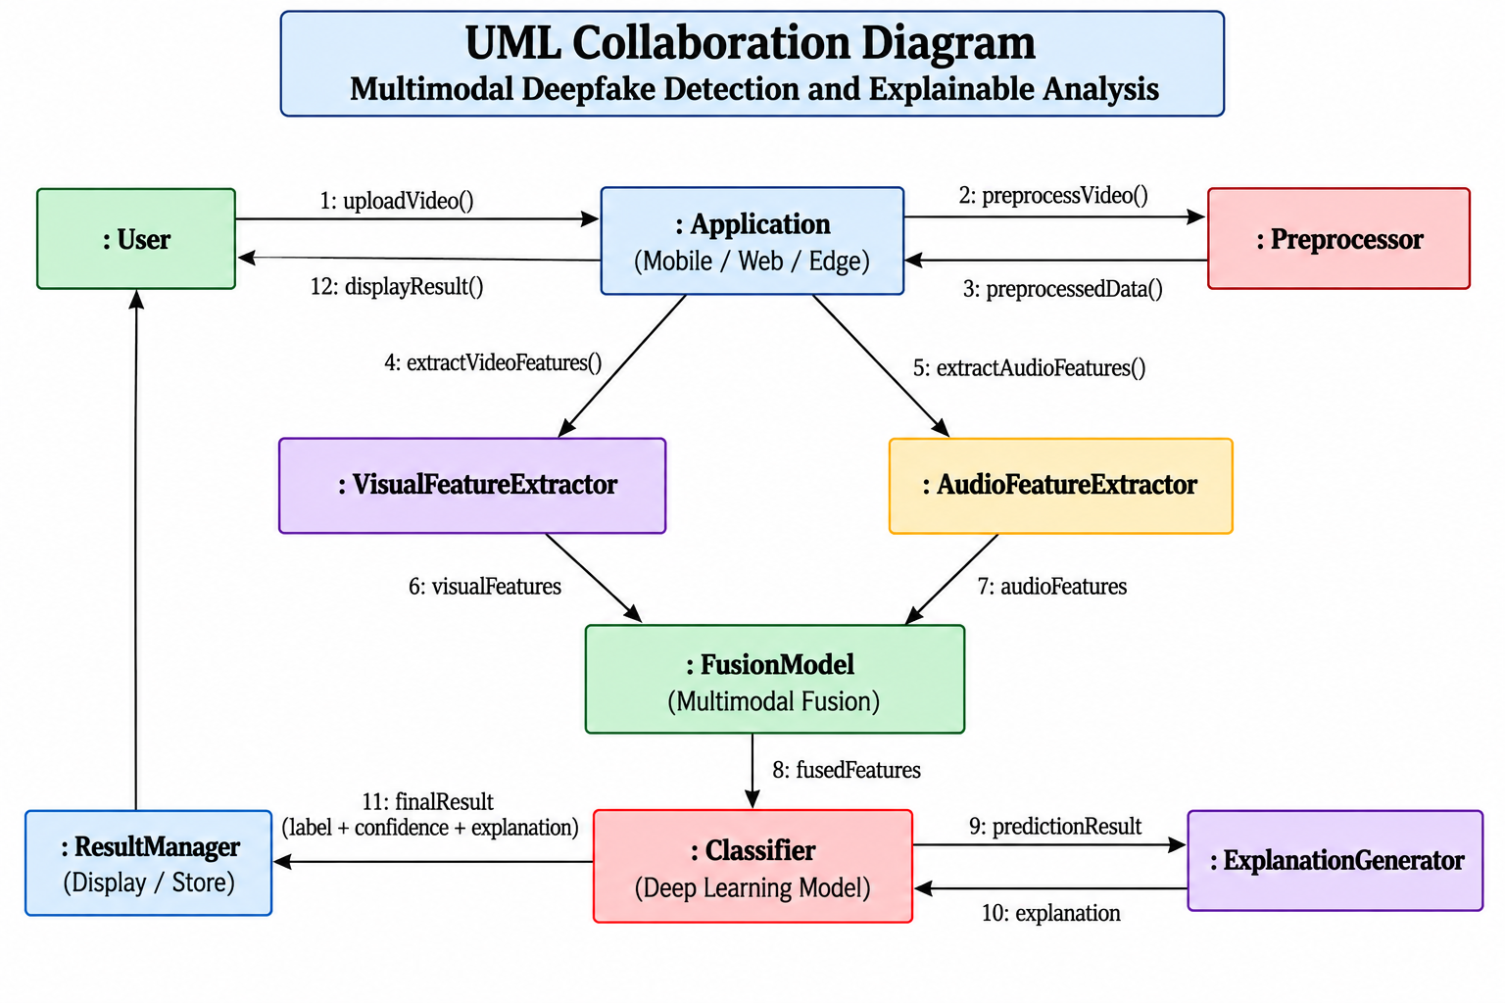
Design Diagrams (cont.)

Slide 26
References
A. Jadhav, D. Narale, R. Kore, U. Shisode and A. Kulange, "Unmasking the Illusion: A Novel Approach for Detecting Deep Fakes using Video Vision Transformer Architecture," 2024 Asian Conference on Intelligent Technologies.
T S. Kulkarni, D. K. Vishwakarma and V. Ranga, "AI vs. AI: Deep Learning Approaches for Detecting Deepfake Content," 2024 1st International Conference on Advances in Computing, Communication and Networking (ICAC2N).
M. Thanga Raj, M. Arunachalam, R. Ramalakshmi, K. Ramaraj, M. Arunachalam and P. Kaleeswari, "A Review on the Detection of Deep Fake and Propaganda Videos and Images-based Voice and Facial Manipulation using AI Techniques," 2023 2nd International Conference on Automation, Computing and Renewable Systems (ICACRS)

Slide 27


